Slide 1


Big Data Infrastructure
CS 489/698 Big Data Infrastructure (Winter 2016)
Week 3: From MapReduce to Spark (2/2)
January 21, 2016
Jimmy Lin
David R. Cheriton School of Computer Science
University of Waterloo
These slides are available at http://lintool.github.io/bigdata-2016w/
This work is licensed under a Creative Commons Attribution-Noncommercial-Share Alike 3.0 United States See http://creativecommons.org/licenses/by-nc-sa/3.0/us/ for details

Slide 2

The datacenter is the computer!
What’s the instruction set?
Source: Google

Slide 3
MapReduce
List[(K1,V1)]
map f: (K1, V1) ⇒ List[(K2, V2)]
reduce g: (K2, Iterable[V2]) ⇒ List[(K3, V3)]
List[K2,V2])

Slide 4
Spark
RDD[T]
RDD[(K, V)]
RDD[(K, V)]
RDD[T]
RDD[T]
RDD[T]
RDD[(K, V)]
flatMap f: (T) ⇒ TraversableOnce[U]
groupByKey
aggregateByKey
seqOp: (U, V) ⇒ U, combOp: (U, U) ⇒ U
map f: (T) ⇒ U
filter f: (T) ⇒ Boolean
mapPartitions f: (Iterator[T]) ⇒ Iterator[U]
RDD[(K, V)]
RDD[(K, W)]
reduceByKey
f: (V, V) ⇒ V
RDD[(K, V)]
RDD[(K, V)]
RDD[(K, W)]
RDD[U]
RDD[(K, Iterable[V])]
RDD[(K, U)]
RDD[U]
sort
RDD[U]
cogroup
RDD[U]
RDD[(K, V)]
join
And more!
RDD[(K, (Iterable[V], Iterable[W]))]
RDD[(K, V)]
RDD[(K, (V, W))]

Slide 5
What’s an RDD?
Resilient Distributed Dataset (RDD)
= immutable
= partitioned
Wait, so how do you actually do anything?
Developers define transformations on RDDs
Framework keeps track of lineage

Slide 6
Spark Word Count
val textFile = sc.textFile(args.input())
textFile
.flatMap(line => tokenize(line))
.map(word => (word, 1))
.reduceByKey(_ + _)
.saveAsTextFile(args.output())

Slide 7
RDD Lifecycle
Transformation
RDD
Action
values
Transformations are lazy:
Framework keeps track of lineage
Actions trigger actual execution

Slide 8
Spark Word Count
RDDs
val textFile = sc.textFile(args.input())
val a = textFile.flatMap(line => line.split(" "))
val b = a.map(word => (word, 1))
val c = b.reduceByKey(_ + _)
c.saveAsTextFile(args.output())
Transformations
Action

Slide 9
RDDs and Lineage
On HDFS
textFile: RDD[String]
.flatMap(line => line.split(" "))
a: RDD[String]
.map(word => (word, 1))
b: RDD[(String, Int)]
.reduceByKey(_ + _)
c: RDD[(String, Int)]
Action!
Remember, transformations are lazy!

Slide 10
RDDs and Optimizations
Lazy evaluation creates optimization opportunities
On HDFS
textFile: RDD[String]
RDDs don’t need to be materialized!
.flatMap(line => line.split(" "))
a: RDD[String]
Want MM?
.map(word => (word, 1))
b: RDD[(String, Int)]
.reduceByKey(_ + _)
c: RDD[(String, Int)]
Action!

Slide 11
RDDs and Caching
RDDs can be materialized in memory!
On HDFS
textFile: RDD[String]
✗
.flatMap(line => line.split(" "))
Cache it!
a: RDD[String]
Fault tolerance?
.map(word => (word, 1))
b: RDD[(String, Int)]
.reduceByKey(_ + _)
c: RDD[(String, Int)]
Action!
Spark works even if the RDDs are partially cached!

Slide 12
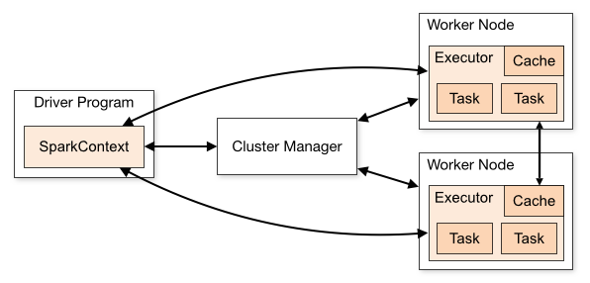
Spark Architecture

Slide 13
Compare
namenode
job submission node
namenode daemon
jobtracker
tasktracker
tasktracker
tasktracker
datanode daemon
datanode daemon
datanode daemon
Linux file system
Linux file system
Linux file system
…
…
…
slave node
slave node
slave node

Slide 14
Spark Programs
Scala, Java, Python, R
spark-shell
spark-submit
Your application
(driver program)
SparkContext
Spark context: tells the framework where to find the cluster
Cluster manager
Local threads
Use the Spark context to create RDDs
Worker
Worker
Spark executor
Spark executor
HDFS

Slide 15
Spark Driver
spark-shell
spark-submit
Your application
(driver program)
val textFile =
sc.textFile(args.input())
textFile
.flatMap(line => tokenize(line))
.map(word => (word, 1))
.reduceByKey(_ + _)
.saveAsTextFile(args.output())
SparkContext
Cluster manager
Local threads
Worker
Worker
Spark executor
Spark executor
What’s happening to the functions?
HDFS

Slide 16
Spark Driver
spark-shell
spark-submit
Your application
(driver program)
val textFile =
sc.textFile(args.input())
textFile
.flatMap(line => tokenize(line))
.map(word => (word, 1))
.reduceByKey(_ + _)
.saveAsTextFile(args.output())
SparkContext
Cluster manager
Local threads
Worker
Worker
Note: you can run code “locally”, integrate cluster-computed values!
Spark executor
Spark executor
HDFS
Beware of the collect action!

Slide 17
Spark Transformations
RDD[T]
RDD[(K, V)]
RDD[(K, V)]
RDD[T]
RDD[T]
RDD[T]
RDD[(K, V)]
flatMap f: (T) ⇒ TraversableOnce[U]
groupByKey
aggregateByKey
seqOp: (U, V) ⇒ U, combOp: (U, U) ⇒ U
map f: (T) ⇒ U
filter f: (T) ⇒ Boolean
mapPartitions f: (Iterator[T]) ⇒ Iterator[U]
RDD[(K, V)]
RDD[(K, W)]
reduceByKey
f: (V, V) ⇒ V
RDD[(K, V)]
RDD[(K, V)]
RDD[(K, W)]
RDD[U]
RDD[(K, Iterable[V])]
RDD[(K, U)]
RDD[U]
sort
RDD[U]
cogroup
RDD[U]
RDD[(K, V)]
join
RDD[(K, (Iterable[V], Iterable[W]))]
RDD[(K, V)]
RDD[(K, (V, W))]

Slide 18
Starting Points
Input File
Input File
InputSplit
InputSplit
InputSplit
InputSplit
InputSplit
InputFormat
RecordReader
RecordReader
RecordReader
RecordReader
RecordReader
“mapper”
“mapper”
“mapper”
“mapper”
“mapper”
Source: redrawn from a slide by Cloduera, cc-licensed

Slide 19
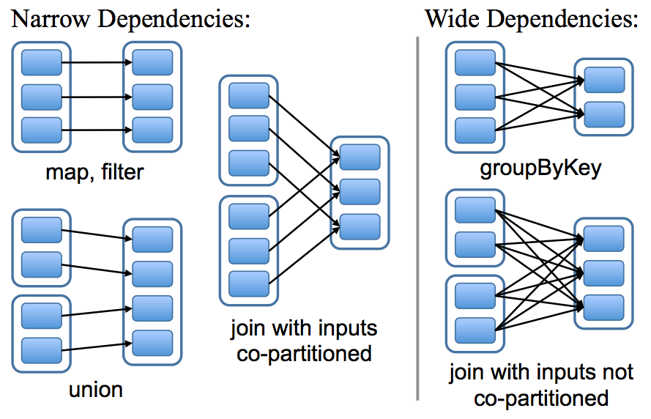
Physical Operators

Slide 20
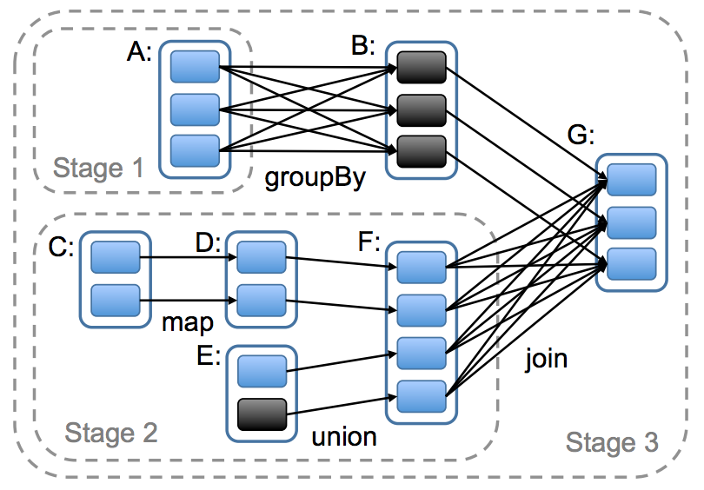
Execution Plan

Slide 21
Can’t avoid this!
…
…

Slide 22
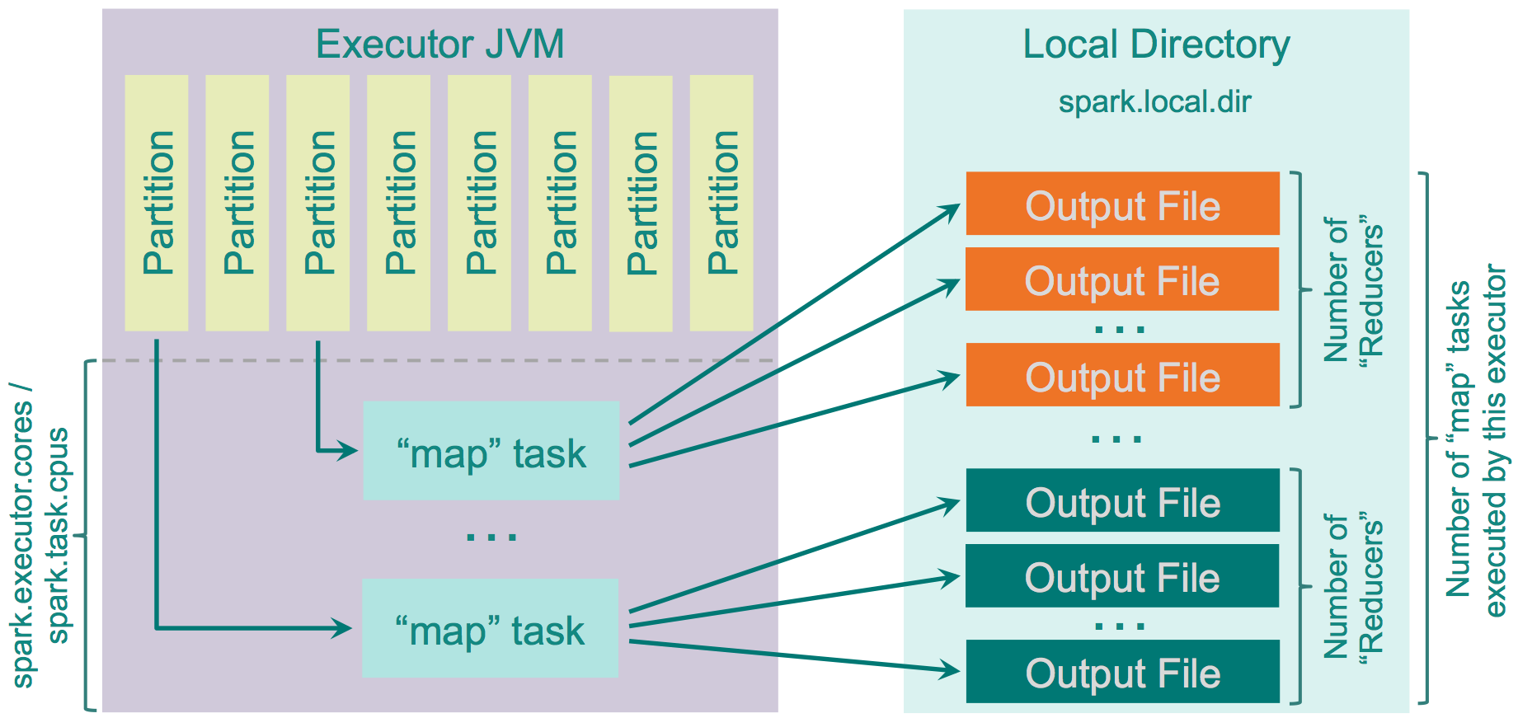
Spark Shuffle Implementations
Hash shuffle
Source: http://0x0fff.com/spark-architecture-shuffle/

Slide 23
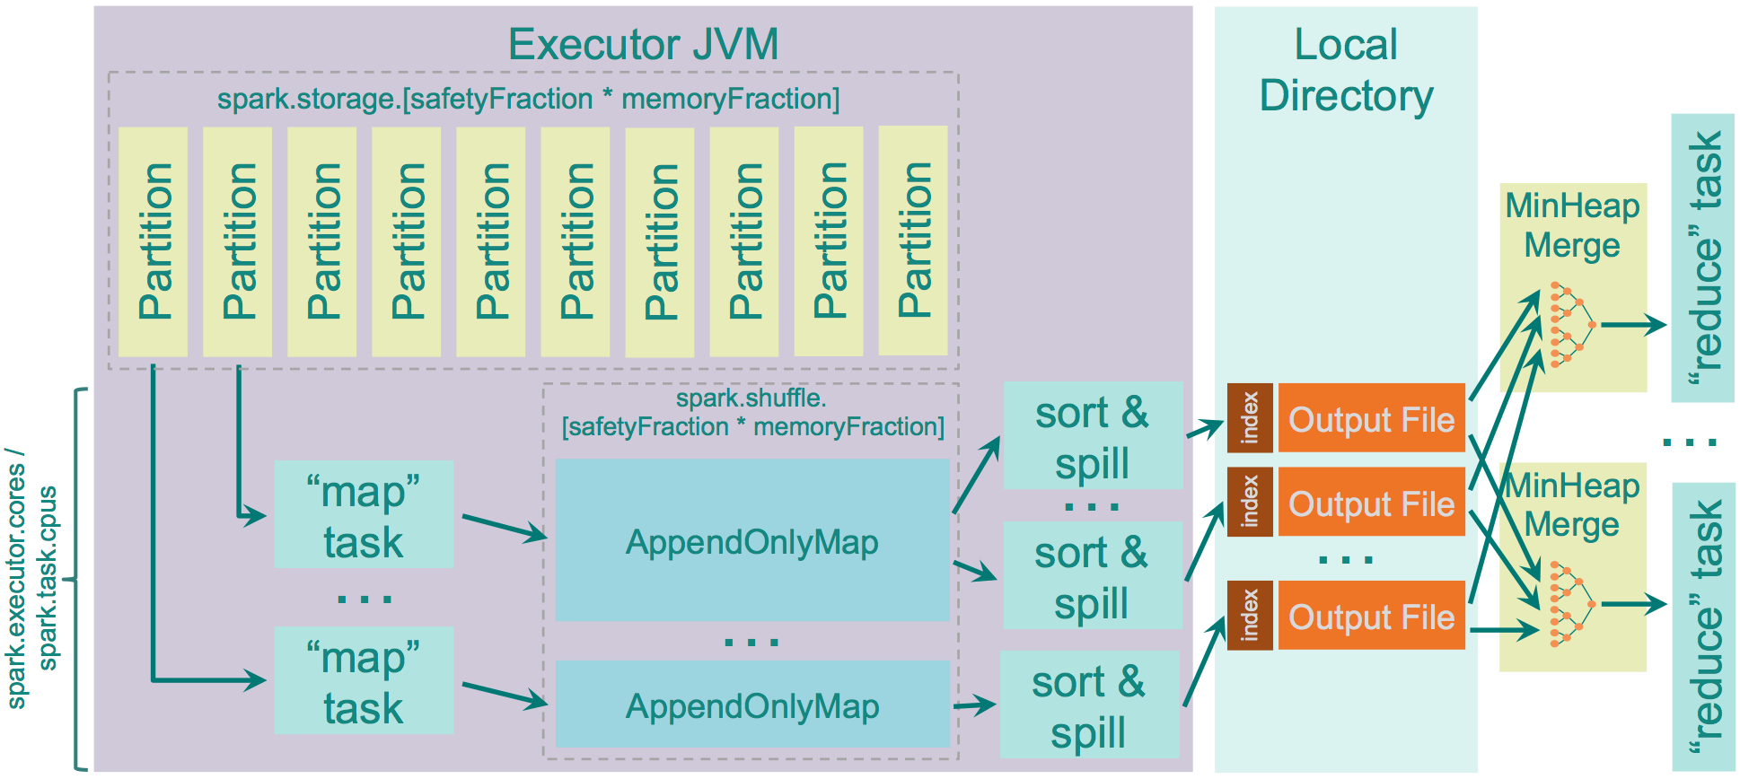
Spark Shuffle Implementations
Sort shuffle
Source: http://0x0fff.com/spark-architecture-shuffle/

Slide 24
Remember this?
Mapper
intermediate files (on disk)
merged spills (on disk)
Combiner
Reducer
circular buffer (in memory)
Combiner
other reducers
spills (on disk)
So, in MapReduce, why are key-value pairs processed in sorted order in the reducer?
other mappers

Slide 25
Remember this?
Mapper
intermediate files (on disk)
merged spills (on disk)
Combiner
Reducer
circular buffer (in memory)
Combiner
other reducers
spills (on disk)
other mappers
Where are the combiners in Spark?

Slide 26
Reduce-like Operations
RDD[(K, V)]
RDD[(K, V)]
reduceByKey
f: (V, V) ⇒ V
aggregateByKey
seqOp: (U, V) ⇒ U, combOp: (U, U) ⇒ U
RDD[(K, V)]
RDD[(K, U)]
How can we optimize?
What happened to combiners?
…
…

Slide 27
Spark #wins
Richer operators
RDD abstraction supports optimizations (pipelining, caching, etc.)
Scala, Java, Python, R, bindings

Slide 28
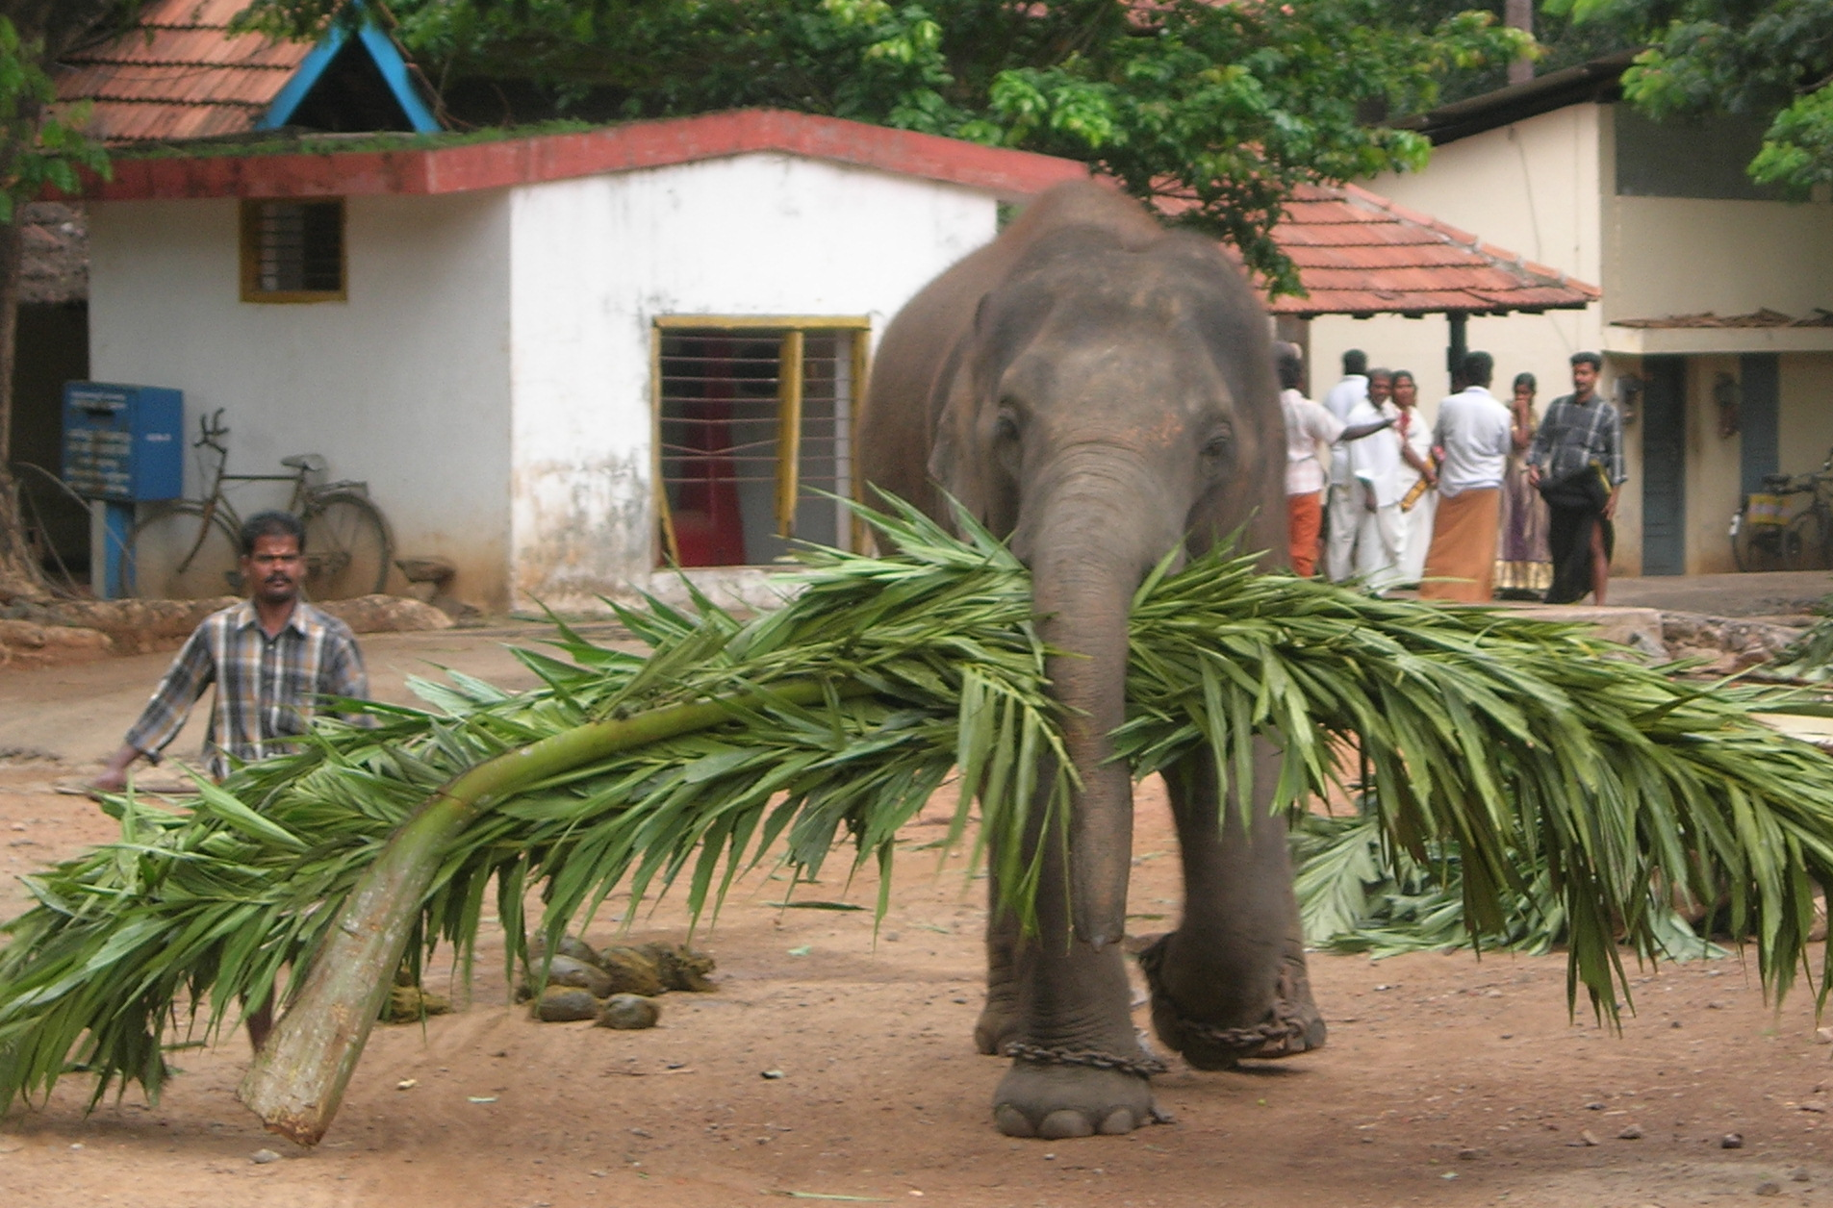
Algorithm design, redux
Source: Wikipedia (Mahout)

Slide 29

Two superpowers:
Associativity
Commutativity
(sorting)
What follows… very basic category theory…

Slide 30
The Power of Associativity
You can put parenthesis where ever you want!
v₁ ⊕ v₂ ⊕ v₃ ⊕ v₄ ⊕ v₅ ⊕ v₆ ⊕ v₇ ⊕ v₈ ⊕ v₉
v₁ ⊕ v₂ ⊕ v₃ ⊕ v₄ ⊕ v₅ ⊕ v₆ ⊕ v₇ ⊕ v₈ ⊕ v₉
v₁ ⊕ v₂ ⊕ v₃ ⊕ v₄ ⊕ v₅ ⊕ v₆ ⊕ v₇ ⊕ v₈ ⊕ v₉
Credit to Oscar Boykin for the idea behind these slides

Slide 31
The Power of Commutativity
You can swap order of operands however you want!
v₁ ⊕ v₂ ⊕ v₃ ⊕ v₄ ⊕ v₅ ⊕ v₆ ⊕ v₇ ⊕ v₈ ⊕ v₉
v₄ ⊕ v₅ ⊕ v₆ ⊕ v₇ ⊕ v₁ ⊕ v₂ ⊕ v₃ ⊕ v₈ ⊕ v₉
v₈ ⊕ v₉ ⊕ v₄ ⊕ v₅ ⊕ v₆ ⊕ v₇ ⊕ v₁ ⊕ v₂ ⊕ v₃

Slide 32
Implications for distributed processing?
You don’t know when the tasks begin
You don’t know when the tasks end
You don’t know when the tasks interrupt each other
You don’t know when intermediate data arrive
…
It’s okay!

Slide 33
Fancy Labels for Simple Concepts…
Semigroup = ( M , ⊕ )
⊕ : M × M → M, s.t., ∀m₁, m₂, m₃ ∋ M
(m₁ ⊕ m₂) ⊕ m₃ = m₁ ⊕ (m₂ ⊕ m₃)
Monoid = Semigroup + identity
ε s.t., ε ⊕ m = m ⊕ ε = m, ∀m ∋ M
Commutative Monoid = Monoid + commutativity
∀m₁, m₂ ∋ M, m₁ ⊕ m₂ = m₂ ⊕ m₁
A few examples?

Slide 34
Back to these…
RDD[(K, V)]
RDD[(K, V)]
reduceByKey
f: (V, V) ⇒ V
aggregateByKey
seqOp: (U, V) ⇒ U, combOp: (U, U) ⇒ U
Wait, I’ve seen this before?
RDD[(K, V)]
RDD[(K, U)]

Slide 35
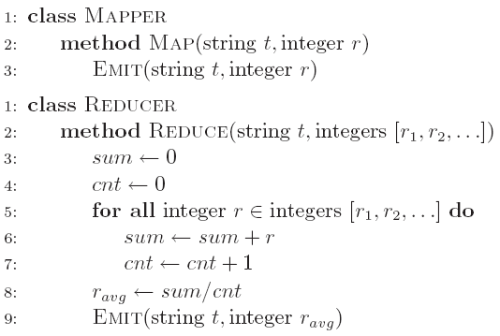
Computing the mean v1 (again)

Slide 36
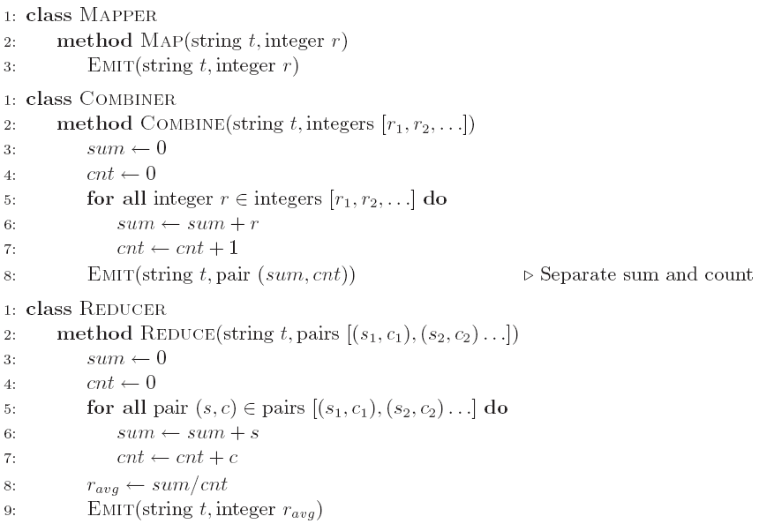
Computing the mean v2 (again)

Slide 37
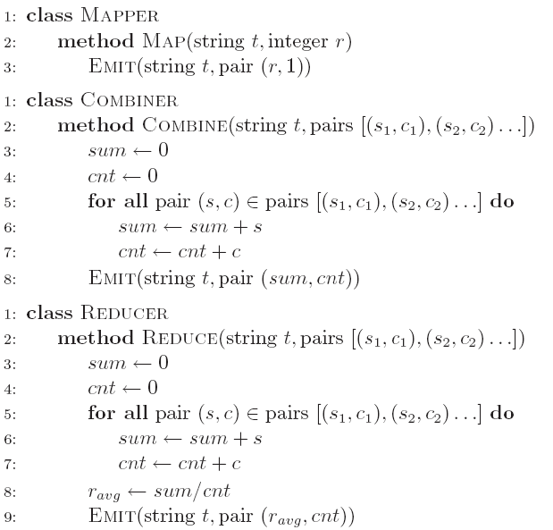
Computing the mean v3 (again)
Wait, I’ve seen this before?
RDD[(K, V)]
reduceByKey
f: (V, V) ⇒ V
RDD[(K, V)]

Slide 38
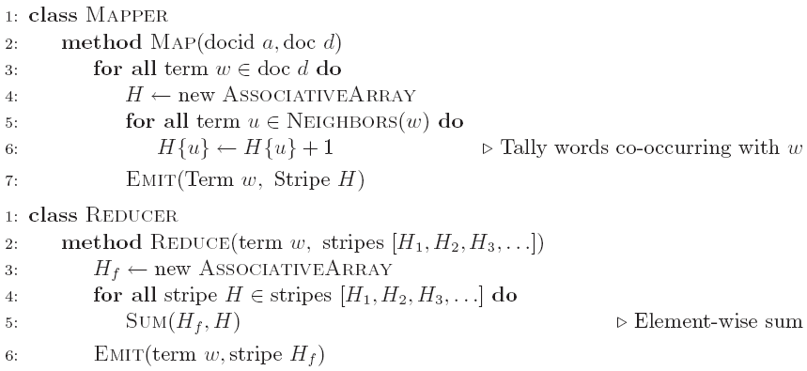
Co-occurrence Matrix: Stripes
Wait, I’ve seen this before?
RDD[(K, V)]
reduceByKey
f: (V, V) ⇒ V
RDD[(K, V)]

Slide 39
Synchronization: Pairs vs. Stripes
Approach 1: turn synchronization into an ordering problem
Sort keys into correct order of computation
Partition key space so that each reducer gets the appropriate set of partial results
Hold state in reducer across multiple key-value pairs to perform computation
Illustrated by the “pairs” approach
Approach 2: construct data structures that bring partial results together
Each reducer receives all the data it needs to complete the computation
Illustrated by the “stripes” approach
What about this?
Commutative monoids!

Slide 40
f(B|A): “Pairs”
For this to work:
Must emit extra (a, *) for every b_{n} in mapper
Must make sure all a’s get sent to same reducer (use partitioner)
Must make sure (a, *) comes first (define sort order)
Must hold state in reducer across different key-value pairs
(a, *) → 32
Reducer holds this value in memory
(a, b₁) → 3
(a, b₂) → 12
(a, b₃) → 7
(a, b₄) → 1
…
(a, b₁) → 3 / 32
(a, b₂) → 12 / 32
(a, b₃) → 7 / 32
(a, b₄) → 1 / 32
…

Slide 41
Two superpowers:
Associativity
Commutativity
(sorting)

Slide 42
Because you can’t avoid this…
…
…
And sort-based shuffling is pretty efficient!

Slide 43
The datacenter is the computer!
What’s the instruction set?
Source: Google

Slide 44
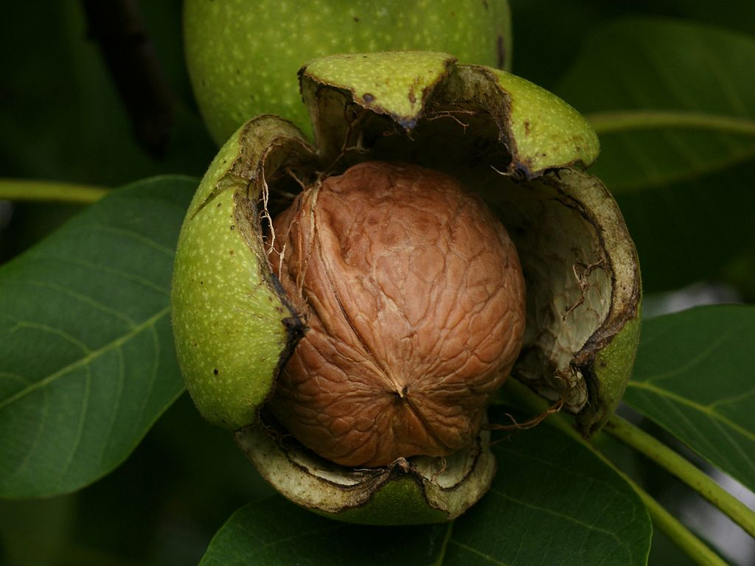
Algorithm design in a nutshell…
Exploit associativity and commutativity via commutative monoids (if you can)
Exploit framework-based sorting to sequence computations (if you can’t)
Source: Wikipedia (Walnut)

Slide 45

Questions?
Remember: Assignment 2 due next Tuesday at 8:30am
Source: Wikipedia (Japanese rock garden)

